Slide 1
Breaking Down IDIS Reports
National Community Development Association Annual Conference
Orlando, Florida
Tuesday, June 13, 2023
Heather Johnson, Community Development Resources Manager
Davenport, Iowa

Slide 2
IDIS Reports
There are two types of reporting:
MicroStrategy Reports
Reports produced by IDIS to show information about federal grant funding, expenditures, and beneficiaries
23 CDBG Reports
20 HOME Reports
20 Overview/operational reports
CAPER Report
The Consolidated Annual Performance and Evaluation Report, which is created by the Grantee in IDIS for submission to HUD to meet statutory reporting requirements

Slide 3
Resources for Reports
Sample
HUD has a guide that lists all reports and their attributes
Very very useful if you don’t know which report to run
https://www.hudexchange.info/onecpd/assets/File/IDIS-Online-Reports-User-Guide-Appendix.pdf

Slide 4
Getting To MicroStrategy Reports
Located under the reports heading
Opens the Report Parameters screen, but not the reports themselves
Click View Reports to open the MicroStrategy System

Slide 5
Getting To MicroStrategy Reports
MicroStrategy will open in a different browser window or tab
You will have one session of IDIS running at the same time as one session of MicroStrategy
IDIS will time out after 20 minutes of inactivity, and it does not recognize the activity happening in the MicroStrategy session
If you’re timed out of IDIS, you will also be timed out of MicroStrategy
If you spend more than a few minutes working on reports, click back into IDIS and click buttons there occasionally to keep it active

Slide 6
Navigating in MicroStrategy Reports
Click IDIS folder to show reports
Click Shared Reports to access the list of standard reports
Custom Reports

Slide 7
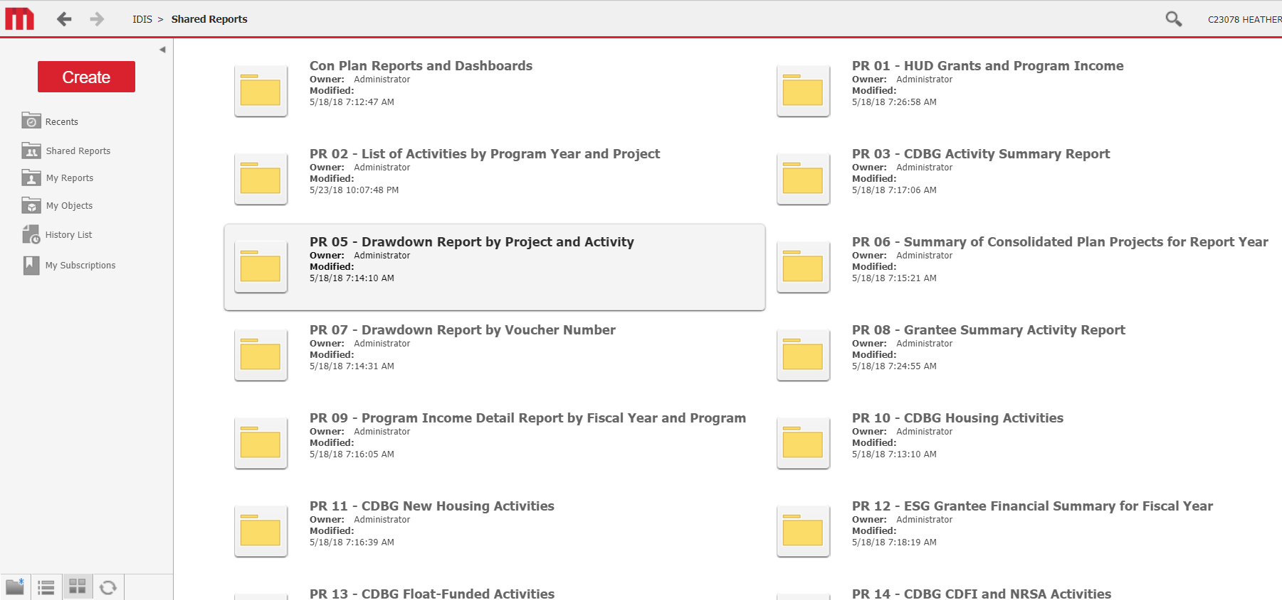
Navigating in MicroStrategy Reports
List looks like this – but MUCH longer!

Slide 8
Navigating in MicroStrategy Reports
Once you click on a report, the screen will change and show navigation links at the top and left sides:
You can use these links to move directly to other reports
Navigation Links
Navigation Links

Slide 9
Navigating in MicroStrategy Reports
Hovering the cursor over the main report icon on the screen shows options that you cannot see when the cursor isn’t hovering there
Not hovering the cursor
Hovering the cursor
Clicking the icon runs the report to the screen
“Export” allows downloading as Excel or CSV
“PDF” allows downloading as PDF

Slide 10
Navigating in MicroStrategy Reports
Once you’ve selected a report, the screen will display all the attribute choices for that report
Every report has different attributes, we can’t cover them all here
We will cover:
General rules for selecting attributes and running reports
Features of some of the most common/useful reports

Slide 11
Selecting Report Attributes
All reports require Grantee Hierarchy
Keep clicking the triangle next to the words (NOT the word itself) until the grantee name is shown
Then, either double click the Grantee name or select it and click the right pointed arrow to move it to the right side box

Slide 12
Selecting Report Attributes
Selecting all other attributes works the same way: either double click or select/click right arrow to move them from the left to the right box
Depending on the report, attributes you can choose from include:
Program: Select CDBG and/or HOME from a longer list of grants
Funding Type: Select one or more funding types from a list that includes EN, PI, RL, AD, PA, CR, etc.
Plan Year: Some reports require you to enter one year, others allow you to leave blank for all years
Date Ranges: Some reports allow you to pick your own dates outside of typical program years
Project and/or Activity ID: some reports allow this level of specificity

Slide 13
Selecting Report Attributes
Generally, follow on screen prompts
Be sure to enter the information in the format requested
Example – all dates are MM/DD/YYYY
Remember – you can’t break anything in the report system!
Play around with options and formats to find ones that work for you.

Slide 14
Formats for Reports
Running to screen
Good for quick checks and updates
Running to PDF
Good for sending to others, saving copies for future reference
Running to Excel
Good if you will need to add, sort, or subtotal numbers differently than MicroStrategy has them displayed
Especially good if you have many activities
On screen options are a bit different for each after selecting attributes

Slide 15
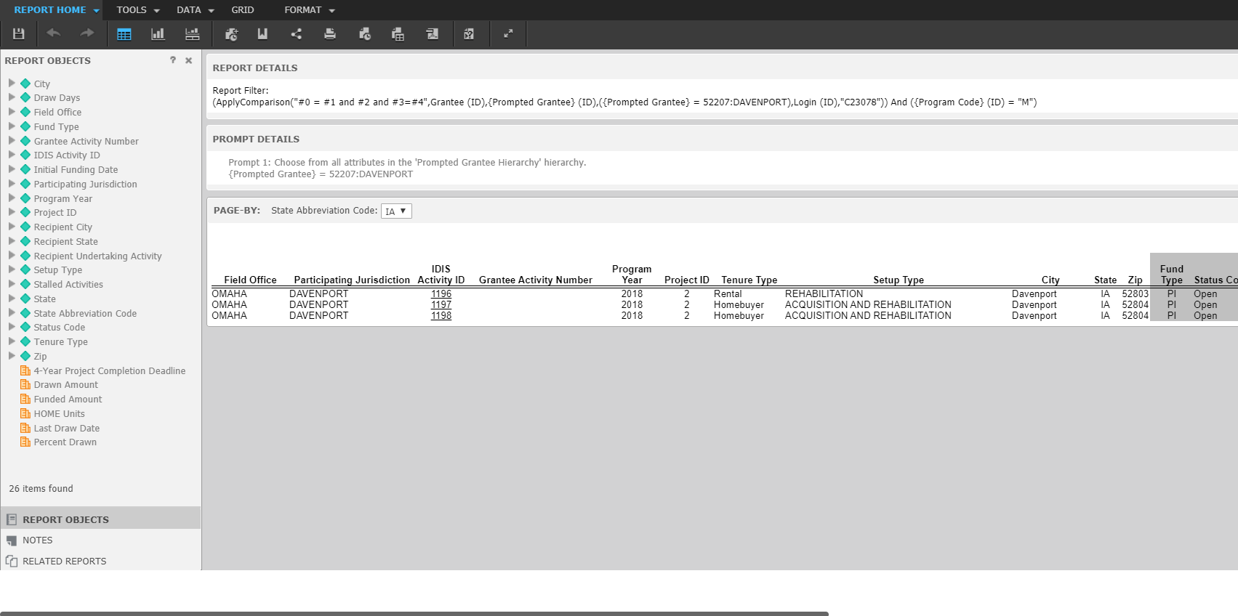
Reports run to screen:
Options for graphs, alternate displays, exporting, sharing, etc.
Remember, you cannot break anything in the reports module, it is view only.
Don’t be afraid to play around and explore these options when you have time.
Lots more information off to the right
Use Scroll Bar

Slide 16
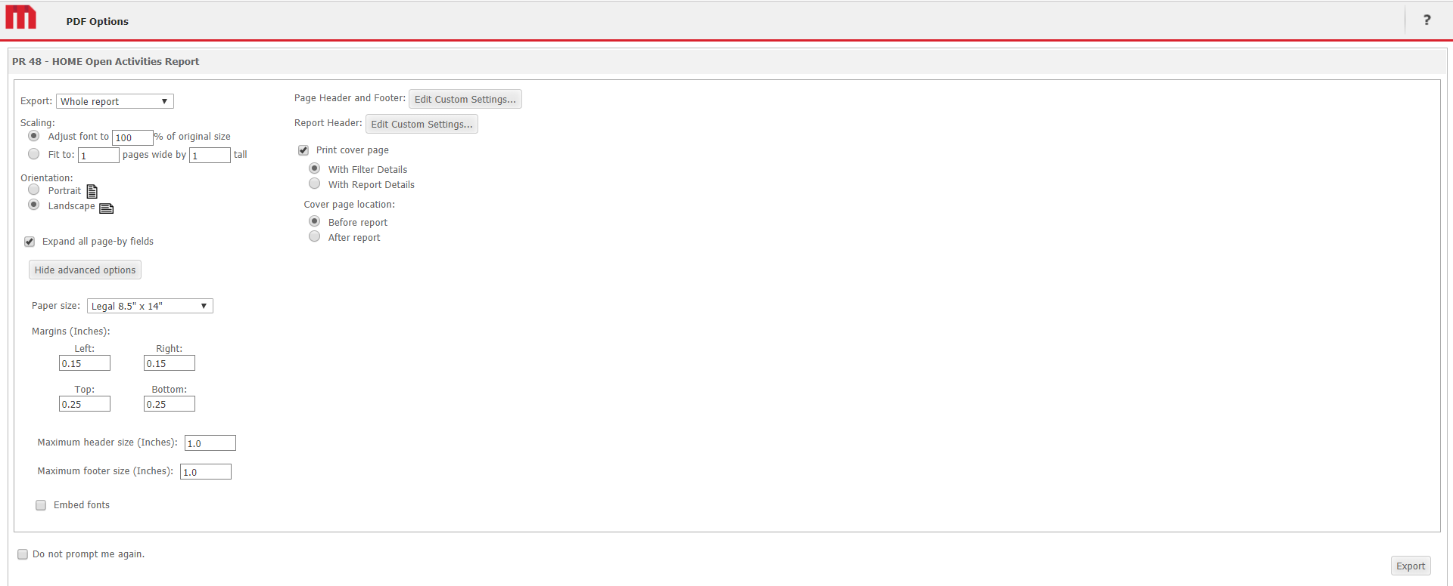
Reports run to PDF
You’ll see a screen with various print options to choose from.
For best results, choose the paper size. Landscape, and the “Fit to” option: enter 1 page wide and leave the box for tall blank.
When finish click Export

Slide 17
Reports run to Excel
You will see a screen with export options.
For best results, export Excel with Plain Text
After selecting the options you want, click Export in the lower right corner.
Report will open in a separate Excel window

Slide 18
Common Administrative Reports
All of these reports can be run for CDBG, HOME, or both
For Grant Status:
PR01 Grants & Program Income, PR02 Activities by Program Year
For Expenditures
PR05 Drawdown Report by Project/Activity, PR07 Drawdown Report by Voucher Number
For Program Income
PR09 Program Income Detail Report
For Consolidate Plan Goals/Accomplishments
Assessment of ConPlan/CAPER (no PR number), PR06 Summary of ConPlan Projects, PR08 Grantee Summary Activity, PR23 Summary of Accomplishments

Slide 19
Common Reports by Program
CDBG
HOME
PR03 Activity Summary – shows expenditures accomplishments for any program year
PR26 Financial Summary – Required part of the CAPER
PR56 Timeliness Report – tracks progress towards goal
PR22 Status of HOME Activities
PR27 Status of HOME Grants
PR33 HOME Matching Liability
PR48 HOME Open Activities
PR49 Deadline Compliance

Slide 20
Reality Check:
This shows who did what and when they did it!
Remember, Everything you do in IDIS is tracked to your user ID.
How do we know? There’s a report for that (PR70)

Slide 21
Use IDIS Reports to Monitor Progress
Don’t wait until the end of the year to run reports – it may be too late to fix issues
Important things to watch:
Progress towards CDBG timeliness (PR56)
Progress towards HOME Match requirement (PR33)

Slide 22
Use IDIS reports to prevent financial issues
Check total amount available by grant, program year and subfund
PR01 HUD Grants and Program Income
Check drawn to date reports before every draw to avoid over or under drawing funds
PR05 Drawdown Report by Project and Activity
Check receipt reports to avoid entering too much or too little PI
PR09 Program Income Detail Report
Check flagged IDIS activities and deadlines
PR46 HOME Flagged Activities Report and PR59 CDBG Activities at Risk Report

Slide 23
Use IDIS Reports to track Accomplishments
Check Accomplishments by individual activity
PR03 CDBG Activity Summary,
Check aggregate Accomplishments (not by activity)
PR23 Accomplishment Report (for both CDBG & HOME)

Slide 24
Questions?

Slide 25
PR23 Summary of Accomplishments Report
Run a separate report for both CDBG and HOME
The only parameters to enter are the grantee name and plan year

Slide 26
PR23 Summary of Accomplishments Report
Report shows three things, sorted by Matrix Code/Activity Type :
Number of IDIS activities (total, # open, # completed)
Sum of accomplishments by type (total, #open, # completed)
Demographics of beneficiaries (grouped by housing/non-housing categories)
What it does not show:
IDIS activity names/numbers
Accomplishments of individual activities

Slide 27
PR23 – Page 1 (IDIS Activities)
Total number of IDIS ACTIVITIES opened or completed in this program year
Should be able to reconcile the number of activities with PR08 or other reports, to ensure that activities are counted in the correct Matrix Code
Notes:
Note that this counts any activity opened in this program year AND any activity from a prior program year that is either still open or was completed in this program year.
Also note that this only counts activities with disbursements – if there is a newly opened activity with no disbursements, it will not be counted on this list.

Slide 28
PR23 – Page 2 (Accomplishments)
Total number of accomplishments entered in this program year
Should be able to reconcile the number of accomplishments with CR05 section of the CAPER, to ensure that activities are counted against the correct ConPlan Goal

Slide 29
PR23 – Page 3 (Beneficiary Race/Ethnicity)
Total number of accomplishments entered in this program year*
Should be able to reconcile the race/ethnicity data with CR10 section of the CAPER
*doesn’t include area benefit activities, for which no race/ethnicity is available

Slide 30
PR23 – Page 4 (Beneficiary Income)
Total number of accomplishments entered in this program year*
This does not directly appear in the CAPER, but is used as part of the LowMod Income Benefit Calculation in PR26, which is a mandatory part of the CAPER
*doesn’t include area benefit activities

Slide 31
ConPlan Report
After selecting the grantee name, you’ll get a choice of plan years
Note, each plan year stands alone – they are not cumulative.
This list will only show plan years without HUD accepted CAPERs

Slide 32
Con Plan Goals & Accomplishments
This report ties directly to the CR05 section of the CAPER
The CR05 report is the “meat” of the CAPER – it is what everything else in the CAPER will jump off from.
The report pulls accomplishment data from IDIS activities and sorts them twice:
First sorts via CDBG Matrix Codes and HOME Activity types into GOI groups
Sorts the GOI groups into Con Plan Goal categories
By the time you see this report, all of the decisions about how the accomplishments were sorted have already been made

Slide 33
Con Plan Goals & Accomplishments
From Con-Plan
From Annual Plan
From IDIS Activities

Slide 34
Common errors:
Underestimated # to be served in ConPlan
Used a GOI in Annual Plan that was not in the Con Plan
Left a GOI out of the Annual Plan that should have been there

Slide 35
Reconcile Accomplishments
Should be able to reconcile this total with PR23 Page 2 and CAPER CR05

Slide 36
Reconciling reports to the real world
Don’t forget that these reports only show what has been entered into IDIS by Grantee staff.
How will you know if what’s in IDIS isn’t correct?
You need to check that real world accomplishments are reflected
Communicate with project managers, make sure their data is entered and correct
Look for obvious red flags in individual activities:
No accomplishments entered at all
Actual accomplishments far higher or lower than proposed
Demographics out of whack for your area or past history
This is a lot easier if you are entering accomplishments regularly throughout the program year!

Slide 37
PR26 Financial Summary Report
PR26 pertains only to CDBG – not HOME
It tracks compliance with several CDBG statutory requirements:
Low/Mod Income Benefit: At least 70% of funds expended for the benefit of low and moderate income residents. This is tracked by single year and multi year certifications (for grantees choosing this option in the ConPlan)
Public Service Cap: No more than 15% of current year grant and 15% of prior year program income expended on public services
Planning/Administration Cap: There are two tests-
Can’t obligate more than 20% to Admin in any program year
Can’t expend more than 20% of any origin grant year on Admin
Can also obligate/expend up to 20% of current year program income for Admin

Slide 38
PR26 Financial Summary Report
PR26 can be intimidating – but don’t worry!
Get help from your finance department – this needs to match their records exactly – HUD will check if they monitor
HUD has really good instructions for how to complete this report!
https://files.hudexchange.info/resources/documents/Updated-Instructions-Completing-CDBG-Financial-Summary-Report-Pr26.pdf

Slide 39
PR26 Financial Summary Report
PR26 is one of the only reports that requires the grantee to enter data before the report can be run.
On the Reports Screen, there’s a link:

Slide 40
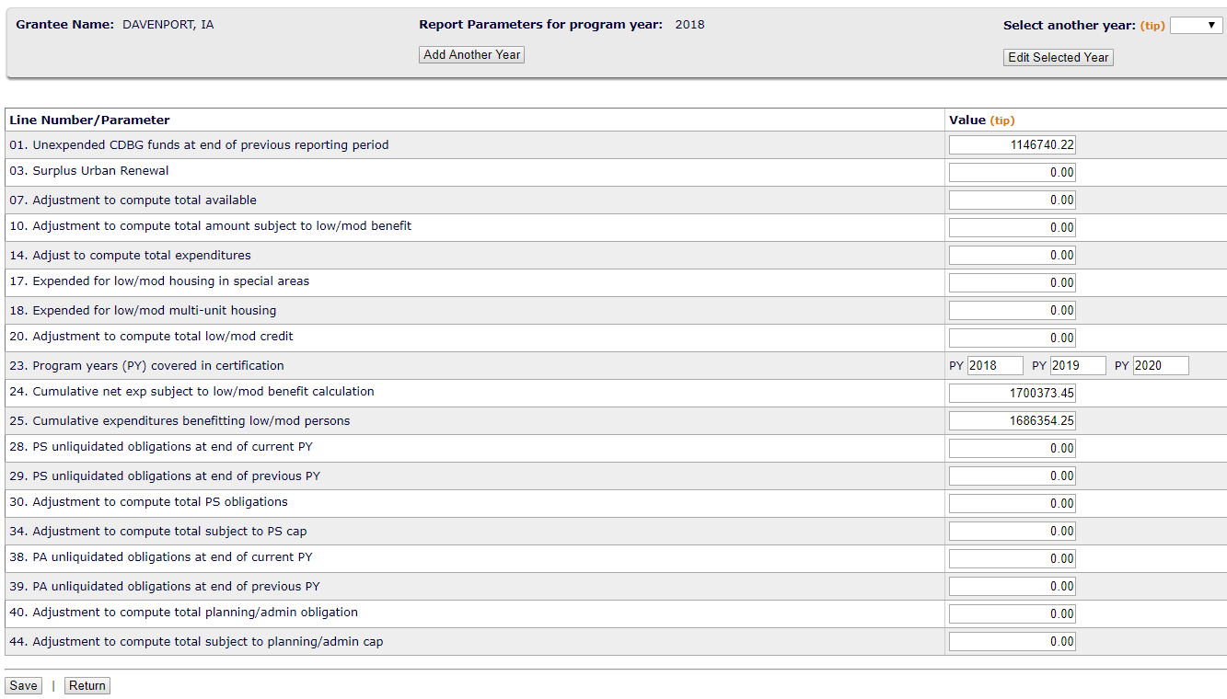
PR26 Financial Report
Add another year if needed
Or select year to Edit
Required for all grantees
Required only for grantees with multi-year low/mod income benefit periods
All other fields are optional
Don’t forget to save!

Slide 41
Required Fields for PR26 Parameters
01. Unexpended CDBG funds at end of previous reporting period
Comes from Line 16 of the previous year’s CAPER
Should also match your finance department’s records!
23. Program years (PY) covered in certification
If you selected a multi year certification in your annual plan, the years you selected should be listed on page 1 of the “Specific Community Development Block Grant Certifications” submitted with your annual plan. Enter the same years here (the current program year must be one of the years!)
24. Cumulative net expenditure subject to low/mod benefit calculation
The sum of Line 11 from the PR26 for each year listed in the certification
25. Cumulative expenditures benefitting low/mod persons
The sum of Line 21 from the PR26 for each year listed in the certification

Slide 42
PR26 Financial Summary Report
After saving parameters, go into MicroStrategy Reports the same as previously described:
Click View Reports
Select IDIS
Click Shared Reports
Chose PR26 from the list of reports
There are two reports to choose from:
Do this first
Then this

Slide 43
PR26 Financial Summary Report
Only two required fields

Slide 44
PR26 Financial Summary Report
The report generates a section for each regulatory requirement. The goals are:
Line 16 Unexpended balance matches grantee records
Line 22 (or 26 for multi-year certifications) is at least 70%
Line 36 for Public Service cap is no more than 15%
Line 46 for Planning/Admin Cap is no more than 20%

Slide 45
If the PR26 doesn’t meet those goals
Use the additional pages generated in the PR26 to determine if there are vouchers included (or not included) in the totals that should be.
The additional pages provide details for
Line 17 Expended for Special Area Housing
Line 18 Expended for Low/Mod Multi Unit Housing
Line 19 Disbursed for Low/Mod Activities
Line 27 Disbursed for Public Services
Line 37 Disbursed for Planning & Administration
You may need to revise vouchers if they are out of place to correct these lines and improve your PR26 percentages

Slide 46
If the PR26 doesn’t meet those goals
Check Program Income:
Line 05 Current Year Program Income should match grantee records
If it doesn’t check to see that all receipts were entered correctly
May need to add or edit receipts if they were missed or entered incorrectly
If receipts from prior or subsequent years are included in the total, may need to enter an adjustment in Line 7 parameters (only as a last resort).

Slide 47
If the PR26 doesn’t meet those goals
Check Expenditures:
Line 15 Total Expenditures should match grantee records
If it doesn’t check to see that all vouchers were entered correctly
Check that any vouchers entered after the program year ended were prior year flagged
May need to add or revise if they were missed or entered incorrectly
If vouchers from prior or subsequent years are included in the total, may need to enter an adjustment in Line 14 parameters (only as a last resort).

Slide 48
Fields you can use to make adjustments:
07. Adjustment to compute total available
10. Adjustments to compute total subject to low/mod benefit
14. Adjust to compute total expenditures
18. Expended for low mod multi unit housing
20. Adjustment to compute total low/mod credit
34. Adjustment to compute total subject to PS cap
40. Adjustment to compute total planning/admin obligation
44. Adjustment to compute total subject to planning/admin cap
Adjustments should be a last resort!
Only use if you can’t adjust the activities/vouchers/receipts directly

Slide 49
If changes are needed to fix PR26:
Add any missing receipts and/or vouchers to IDIS
Revise any vouchers that were entered incorrectly
Edit or delete any receipts entered incorrectly
Update any parameters on the entry screen that are necessary
Wait at least one day for the MicroStrategy reports to update
Re-run the PR26 the next day
Do it all again if there are still problems!
Include explanation of any adjustments in CR15 and/or an attachment

Slide 50
Questions?

